Slide 1
AB Testing Report
Kathy
April 18, 2020
Notes:
Clarify my audience!!
P-value trend – can mention it or plot it. Said our data significant level is stable

Slide 2
Content
1.
Background
2.
Campaigns Timeline
Metrics
3.
Overall Analysis
4.
Deep dive – cut by dimensions
5.
Conclusion

Slide 3
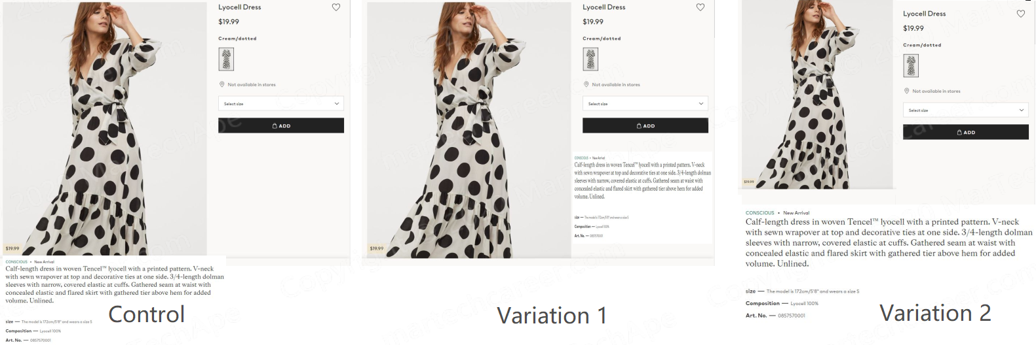
BACKGROUND
Test 1 – Product Detail Changes
Hypothesis:
If we change our product detail location
Then ATCR will increase 0.3%
Because there was a similar test on browser page we launched before.
Notes:
量化 because

Slide 4
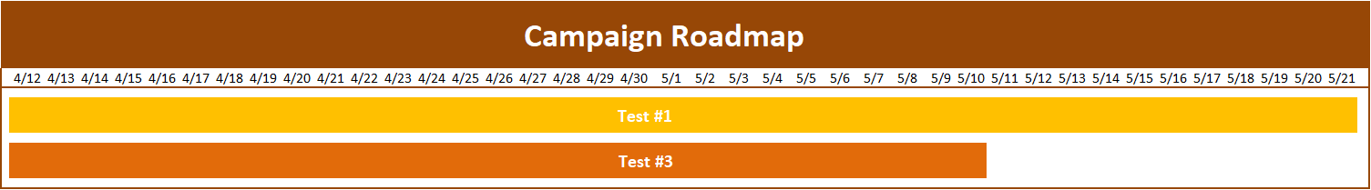
Campaign timeline
Notes:
Testing (not campaign)
Overlap how to analysis, how to (table!)

Slide 5
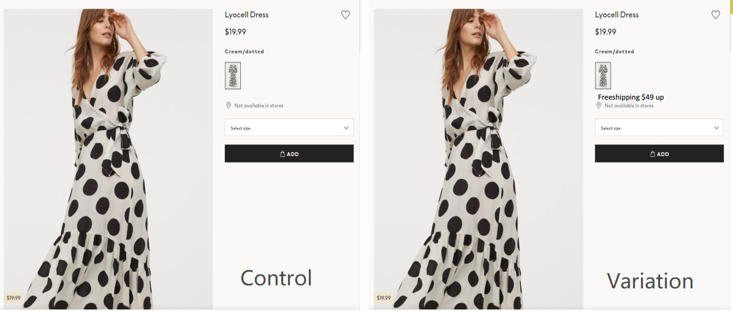
BACKGROUND
Test 3 – Free Shipping Banner
Notes:
Name, responsible (link / doc) no ralated

Slide 6
Executive Summary
Test 1 performs better when it comes to specific users like customers acquired by email and returning users. Suggest rolling out variation 1
Returning users react better on test 3. Suggest rolling out Test 3 on returning users and test the effect when moving the banner to checkout page.
Notes:
Primary Metrics (0.3%+), other metric no harm

Slide 7
Traffic Flow chart
Product Page
Add to Cart
Checkout
Converted
BR
BR
ATCR
C/O
CVR
Rev
Primary
Notes:
Color should make sense (flow brown, metric yellow)
Metric formula
C/O explain

Slide 8
Primary Metrics
BR
ATCR
C/O
CVR
Rev

Slide 9
Overall analysis
Test 1
Variation 1 works well (ATCR+)
Variation 2 underperformed than Variation1
Reduced impulse spending
Test 3
Users may go back to add more to their carts or leave because free shipping banner (ATCR-, C/O+, BR-)
 | test1 |  | test3
 | v1 | v2 | var
BR | No Sig | 11.40% | -0.61%
ATCR | 0.35% | -11.55% | -1.33%
C/O | No Sig | No Sig | 1.38%
CVR | No Sig | -1.19% | No Sig
Rev | -0.33% | No Sig | -2.90%
* Session level
Notes:
*, **, ***Significant level
ATCR 0.2%+
Check Rev customer level (+) okey, (-) ----→a. cost (-) / b. cost(+)
because of data problem,V2 not suggest to apply this test (if you interested, we can ......)

Slide 10
Test 1 Deep dive - cut by visitor type
Test 1 | Variation 1
Visitor Type | BR | ATCR | C/O | CVR
New users | No sig | No sig | No sig | No sig
Email required visitors | No sig | 1.03% | No sig | No sig
Sign up with no purchase | No sig | No sig | No sig | No sig
Users with purchase history | No sig | 0.43% | -0.79% | No sig
Suggest rolling out variation 1 since there is no directional negative effect on metrics
Users who have purchase history have a decline on C/O because they may be discouraged for the higher value of cart. Suggest the next step is to test this group.
Notes:
Test 1 and test 3 replace with name
Rev

Slide 11
Test 1 variation 1 Cut by Category
Pants
Shoes
Products like pants and shoes need more size information than others for users to make sure they fit.
*95% sig, **99% sig, ***99.9% sig
Notes:
Based on this , further test (category: dif channel to cat, class clusting)

Slide 12
Test 1 variation 1 Cut by Category
Shoes
Next Step: to test why Tops and Shoes have significant decline on C/O

Slide 13
Test 3 cut by visitor type
Test 3 | Variation
Visitor Type | BR | ATCR | C/O | CVR
New users | No sig | No sig | No sig | No sig
Email required visitors | No sig | No sig | No sig | No sig
Sign up with no purchase | No sig | -2.10% | No sig | -1.09%
User with purchase history | -1.79% | 0.32% | 0.01% | No sig
Users sign up without purchase may go back to add more products or leave because free shipping banner while they may tend to abandon the higher value of cart
Users with purchase history react better. Suggest rolling out test 3 on all users except sign up without order

Slide 14
Test 3 cut by CATEGORY
Test 3 | Variation
Category | BR | ATCR | C/O | CVR
Dress | -2.00% | -0.83% | 0.64% | No sig
Skirts | No sig | -2.07% | 3.37% | No sig
Tops | No sig | -2.26% | 2.61% | No sig
Shoes | No sig | -2.22% | 4.56% | No sig
Pants | 1.56% | -3.08% | No sig | No sig
A strong signal that users would like to go back and add more product to get free shipping.
C/O increases because there is no unexpected shipping fee.
Suggest rolling out test 3 on all the categories expect pants.
Nest step: test the user behavior who shop pants

Slide 15
Conclusion
Test 1
Location of description
Test 3
Free shipping banner
Recommendation:
Suggest rolling out Test 1
Suggest rolling out Test 3 on all users except sign up without purchase
Next Step:
Test 1 can go further test on why returning users are more likely to abandon cart when checkout.
Test 3: Launch a test to check why ATCR and CVR decline for sign up without purchase group
Check test 3 effect when moving the banner to checkout page to see if it will raise the C/O
Notes:
Next step: run test 3 check, how to test? What is it like-user testing!
Test3 v + test1 cv

Slide 16

Thank you!

